Slide 1
DEPRESSION DETECTION IN SOCIAL MEDIA USING MACHINE LEARNING
(ML-Based | Flask + React )
PRESENTED BY
GOKULRAJ P – 810022104099
SANJAY S - 810022104108
Guided By
Dr.G.ANNAPOORANI

Slide 2
Abstract
This project focuses on detecting signs of depression from social media posts using machine learning techniques.
The working process begins with collecting textual data from social media platforms, followed by preprocessing steps such as data cleaning, tokenization, normalization, and removal of stop words.
Meaningful features are extracted using methods like TF-IDF or word embeddings to represent textual patterns.
A classification algorithm such as Naïve Bayes, Support Vector Machine, or logistic regression is trained on labeled data to identify depressive content.
The system analyzes new posts and predicts whether they indicate depression, supporting early mental health awareness and intervention.

Slide 3
Objectives
Problem Statement
Depression often goes unnoticed because individuals hesitate to seek professional help. Social media users frequently express emotions, thoughts, and personal struggles online, but manual monitoring is impossible due to large data volume. There is a need for an automated system to detect depressive patterns from textual data efficiently and accurately.
Proposed Solutions
The proposed solution uses machine learning algorithms to analyze social media posts and classify them as depressive or non-depressive. The system performs text preprocessing, feature extraction, and model training to recognize emotional patterns. It provides automated predictions that help in early identification and mental health monitoring support.

Slide 4
Literature Review
Year | Authors | Key Findings | Advantages | Limitations
2024 | K. Poongodi, R. A. Nivesh, J. Q. Blessed Jeberson, V. S. Divakar, S. Gowshikan | Integrated Beck’s Depression Inventory (BDI) with emotion detection using GAN for improved depression assessment and intervention support. | Combines psychological assessment with AI-based emotion detection; improves accuracy and intervention planning. | Requires structured questionnaire data; GAN models increase computational complexity.
2021 | M. Kang, S. Oh, K. Oh, S. Kang, Y. Lee | Used deep learning models to predict BDI scores from EEG signals. | Objective EEG-based prediction; reduces dependence on self-reporting. | EEG data collection is costly and requires specialized equipment.
2021 | L. Minkowski, K. V. Mai, D. Gurve | Applied feature extraction techniques to identify depression and anxiety from EEG signals. | Efficient feature extraction improves classification performance. | Limited dataset size; EEG signals may contain noise affecting accuracy.

Slide 5
Literature Review
Year | Authors | Key Findings | Advantages | Limitations
2021 | Z. Tao, S. Liu, B. Li | Studied correlation between frailty and depression in elderly patients with chronic kidney disease. | Highlights medical correlation factors; supports clinical decision-making. | Focused only on elderly CKD patients; limited generalization.
2021 | S. Prabhudesai, A. Mhaske, M. Parmar, S. Bhagwat | Conducted comparative analysis of deep learning models for depression detection. | Provides performance comparison of multiple models; identifies best-performing approach. | Primarily experimental; lacks real-world deployment validation.

Slide 6
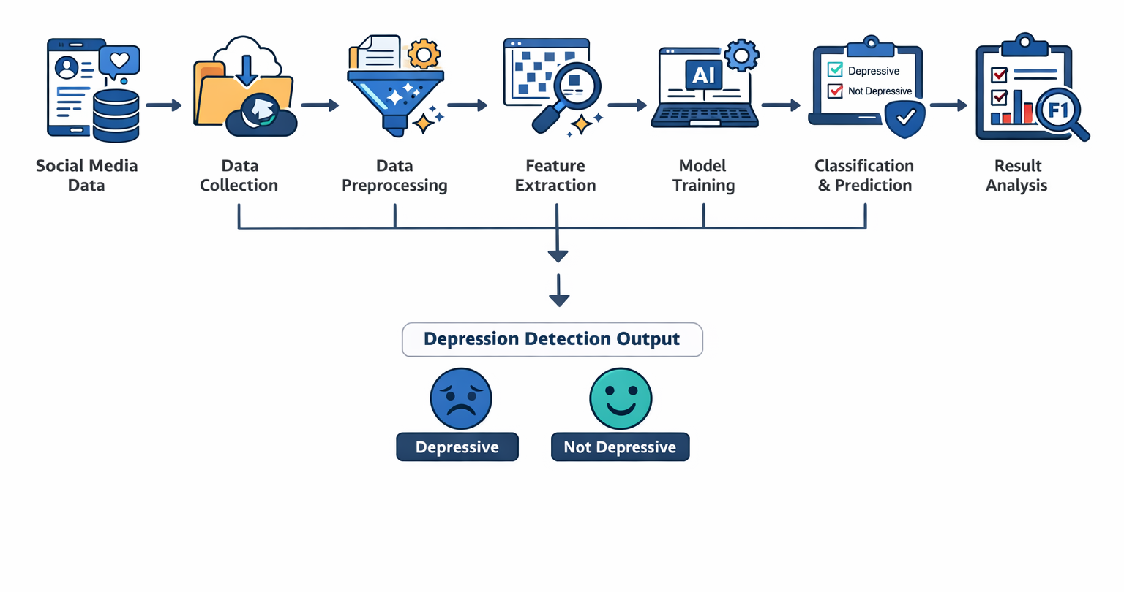
Architecture

Slide 7
SYSTEM MODULES
Data Collection Module
Data Preprocessing Module
Feature Extraction Module
Model Training Module
Classification & Prediction Module
Result Analysis Module

Slide 8
Methods and Techniques
This project uses supervised machine learning techniques to detect depression from social media text. Initially, text data is collected and preprocessed through cleaning, tokenization, lowercasing, and removal of stop words and special characters. Feature extraction methods such as Term Frequency–Inverse Document Frequency (TF-IDF) and word embeddings are applied to convert text into numerical form.
Classification algorithms like Naïve Bayes, Support Vector Machine (SVM), and Logistic Regression are used to train the prediction model.
The dataset is divided into training and testing sets, and performance is evaluated using accuracy, precision, recall, and F1-score metrics.

Slide 9
Requirement Analysis
HARDWARE REQUIREMENT:-
OS: WINDOWS 11
RAM : 16 GB
HARD DISK : 1 TB
SOFTWARE REQUIREMENT:-
FRONT END - HTML,CSS
BACK END - PYTHON
FRAMEWORK - FLASK

Slide 10
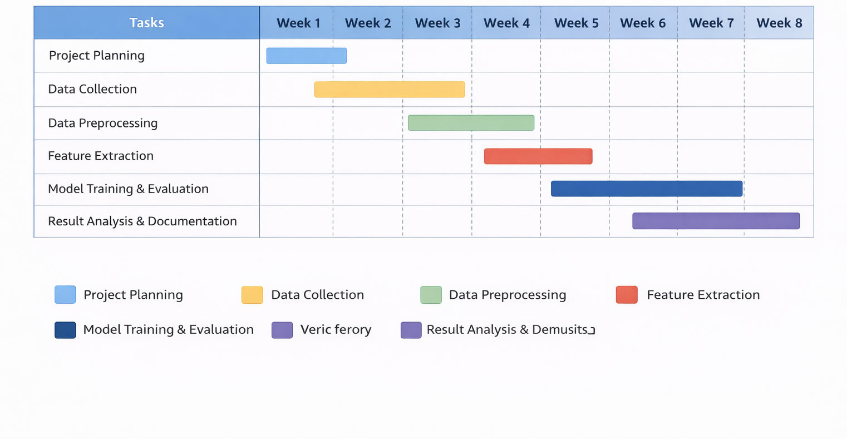
PROJECT TIME LINE

Slide 11
Conclusion
The Depression Detection in Social Media using Machine Learning project demonstrates how textual data can be effectively analyzed to identify signs of depression.
By applying preprocessing techniques, feature extraction methods, and classification algorithms, the system can distinguish between depressive and non-depressive content with reliable performance.
This approach highlights the potential of artificial intelligence in supporting mental health awareness and early identification.
Although it does not replace professional diagnosis, it can serve as a supportive tool for monitoring emotional patterns. Overall, the project shows that machine learning can play a meaningful role in addressing mental health challenges in digital environments.

Slide 12
REFERENCE
K. Poongodi, R. A. Nivesh, J. Q. Blessed Jeberson, V. S. Divakar and S. Gowshikan, "Integrating Beck's Depression Inventory and Emotion Detection Using GAN for Comprehensive Depression Assessment and Intervention," 2024 2nd International Conference on Sustainable Computing and Smart Systems (ICSCSS), Coimbatore, India, 2024, pp. 1038-1046, doi: 10.1109/ICSCSS60660.2024.10625574.
M. Kang, S. Oh, K. Oh, S. Kang and Y. Lee, "The deep learning method for predict beck's depression inventory score using EEG," 2021 International Conference on Information and Communication Technology Convergence (ICTC), Jeju Island, Korea, Republic of, 2021, pp. 490-493, doi: 10.1109/ICTC52510.2021.9620922.
L. Minkowski, K. V. Mai and D. Gurve, "Feature Extraction to Identify Depression and Anxiety Based on EEG," 2021 43rd Annual International Conference of the IEEE Engineering in Medicine & Biology Society (EMBC), Mexico, 2021, pp. 6322-6325, doi: 10.1109/EMBC46164.2021.9630821.
Z. Tao, S. Liu and B. Li, "Correlation Study of Frailty and Depression in elderly patients with Chronic Kidney Disease," 2021 11th International Conference on Information Technology in Medicine and Education (ITME), Wuyishan, Fujian, China, 2021, pp. 412-415, doi: 10.1109/ITME53901.2021.00089.
S. Prabhudesai, A. Mhaske, M. Parmar and S. Bhagwat, "Depression Detection and Analysis Using Deep Learning: Study and Comparative Analysis," 2021 10th IEEE International Conference on Communication Systems and Network Technologies (CSNT), Bhopal, India, 2021, pp. 570-574, doi: 10.1109/CSNT51715.2021.9509707.

Slide 13
Thank You

